Slide 1
WEB BASED BUS RESERVATION TICKET SYSTEM
SOFTWARE ENGINEERING MINI PROJECT BY :- 21305 ANURAG SINGH
21306 Kishan Prajapati
21307 vikas Yadav
21308 ankush singh

Slide 2
TABLE OF CONTENTS
INTRODUCTION
DOCUMENTATION
ANALYSIS
SOFTWARE REQUIREMENT SPECIFICATION (SRS)
MODULES
PROCESS MODEL
CONTEXT MODEL
ENTITY RELATIONSHIP MODEL
USE CASE DIAGRAM

Slide 3
INTRODUCTION
Online bus ticket reservation system is windows based application that works with in centralized network. Bus Booking System is a web based application which is connected to a complete database. The application gives utmost importance to security and usability. As travel industry is evolving from day to day, so the industry needs to digitalize all the bookings and transactions. This project helps to manage bus scheduling and bookings. This Bus Booking System is a easily deployable, integrated end-to-end system starting from searching bus routes to book them.

Slide 4
DOCUMENTATION
A web-based Bus Reservation and Ticketing System is a
generic web portal application that aids bus customers to reserve a seat in a certain
bus company anytime and anywhere and variety of buses that satisfy the
customer’s requirements are provided. The project, on the bus company’s side,
serves as a marketing strategy and aids an efficient processing and delivery of
itinerary receipts.

Slide 5
ANALYSIS
The main purpose of this study is to automate the manual procedures of reserving a bus ticket for any journey. Specifically, objectives of this project will consist of:
Providing a web-based bus ticket reservation function where a customer can buy bus ticket through the online system without a need to queue up at the counter to purchase a bus ticket.
Enabling customers to check the availability and types of buses online. Customer can check the time departure for every bus through the system.
Easing bus ticket payment by obtaining a bank pin after payments is made to
the various designated banks and many other payment systems.
Ability of customers to cancel their reservation.
Admin user privileges in updating and canceling payment, route and vehicle
records.

Slide 6
SOFTWARE REQUIREMENT SPECIFICATION
Hardware Requirements
Processor : Pentium IV with at-least 1 GHz
RAM : 512 MB
Hard Disk : 5 GB
Client Side Requirement Server Side Requirement
Processor : Intel i3 1.5 GHz Processor : Intel i3 2.5 GHz
RAM : 512 MB RAM or above RAM : 1 GB
Hard Disk : 80 GB or above Hard Disk : 40 GB

Slide 7
SOFTWARE REQUIREMENTS
Software Configuration Client Side requirement
Operating System : Windows Based System Operating System : Windows 7/10/11 or other compatible OS
Front End : ASP.NET with PHP Web Browser: Microsoft Edge, Google Chrome or other compatible browser
Back End : SQL server 2005 Server Side Requirement
Web Server : Apache Tomcat 6.0 Front End : PHP 5.3.0
Language Used : Java, JSP, CSS Back End : MySQL 5.1.36
Database : MySQL Web Server : WAMP 2.1
Reporting Tools : HTML report
Other Tools : Apache V2.2.12

Slide 8
MODULES
LOGIN/SIGN IN/SIGN UP MODULE.
ROUTE MODULE.
BUSES MODULE.
PAYMENT MODULE.
SEARCH MODULE.
TICKETS MODULE.
JOURNEY MODULE.
HELP MODULE.

Slide 9
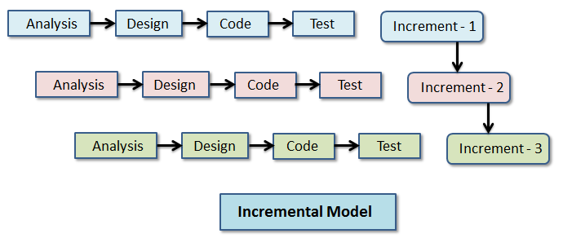
PROCESS MODEL

Slide 10
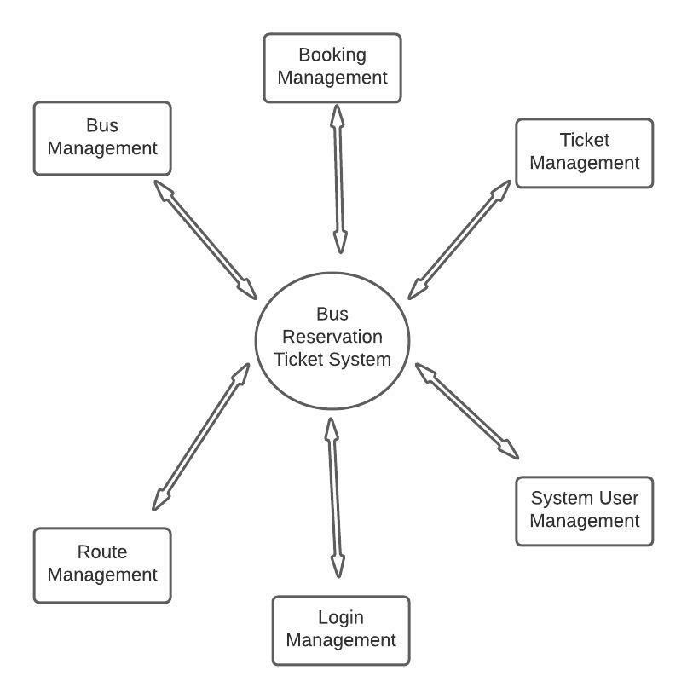
CONTEXT MODEL

Slide 11
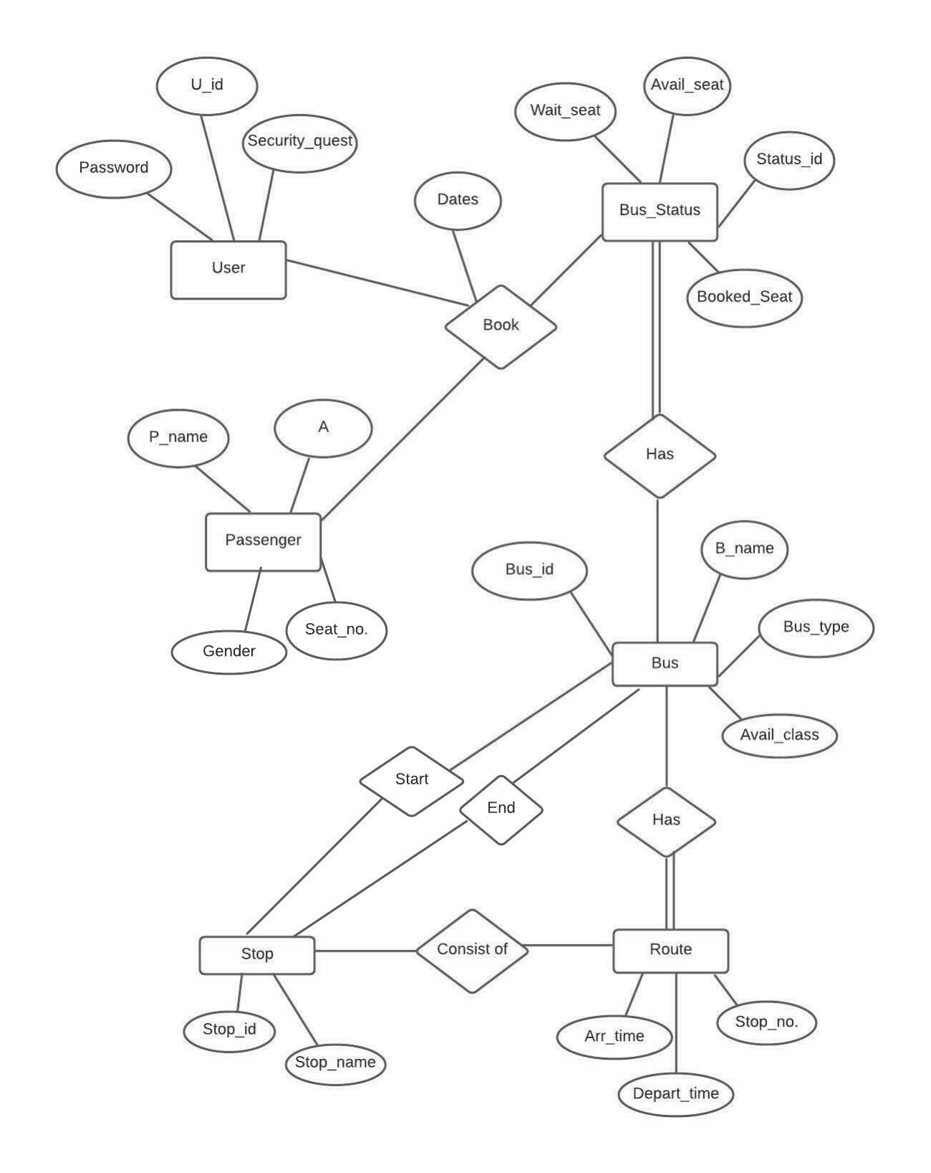
ENTITY RELATIONSHIP MODEL

Slide 12
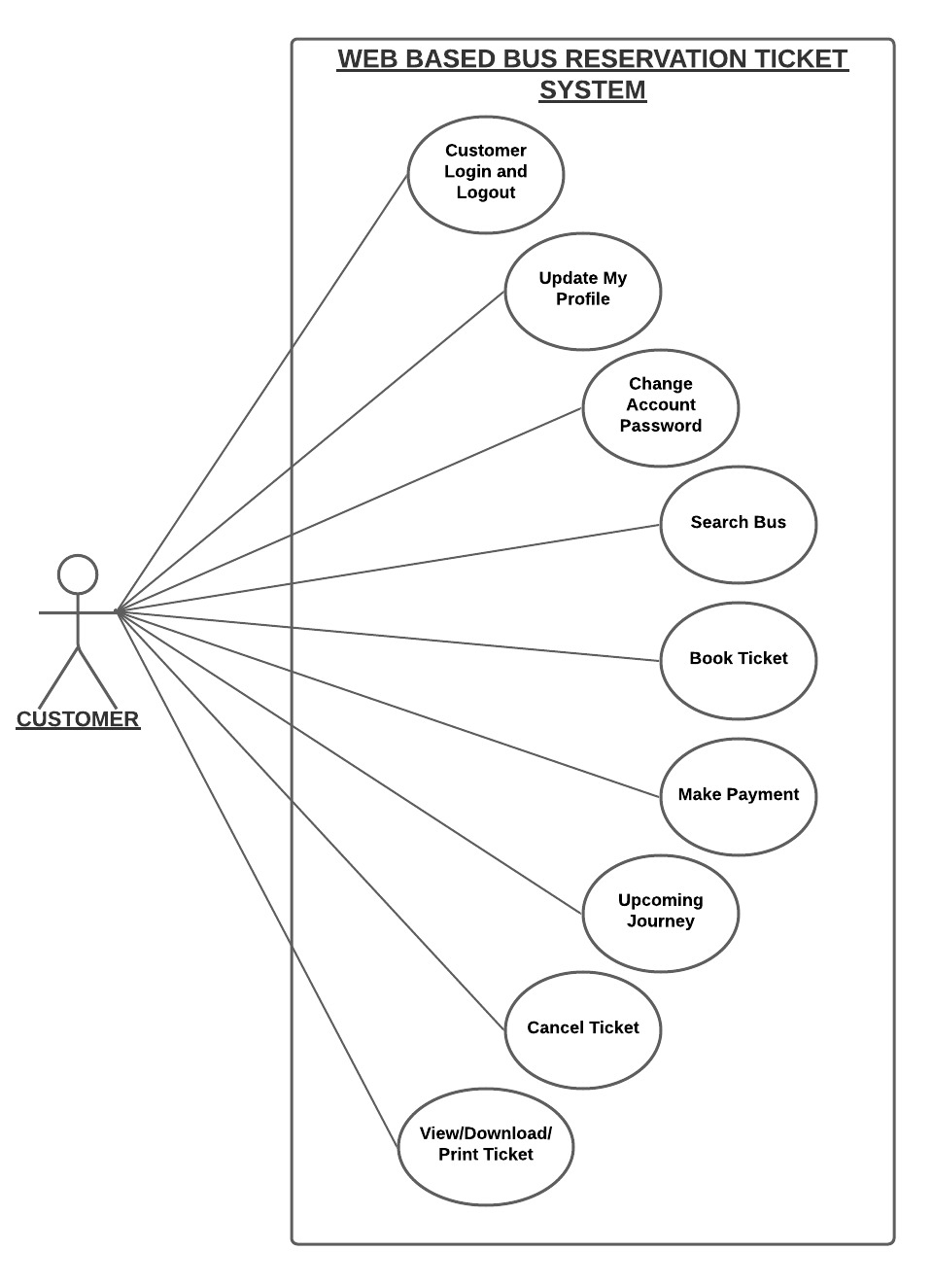
USE CASE DIAGRAM (FOR CUSTOMER)
“A use case is a description of a system’s behaviour as it responds to a request that originates from outside of that system (the user).”

Slide 13
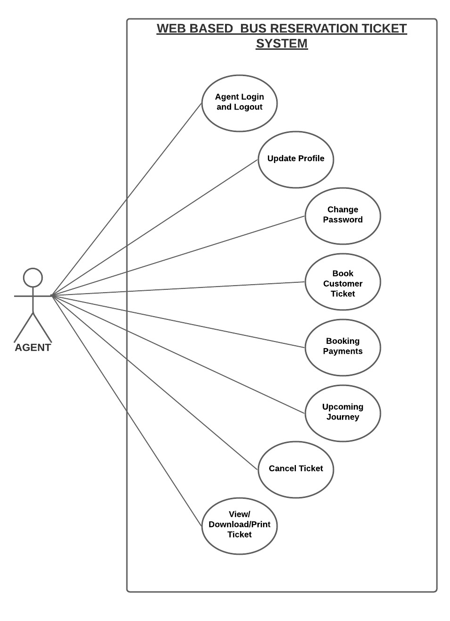
USE CASE DIAGRAM (FOR AGENT)

Slide 14
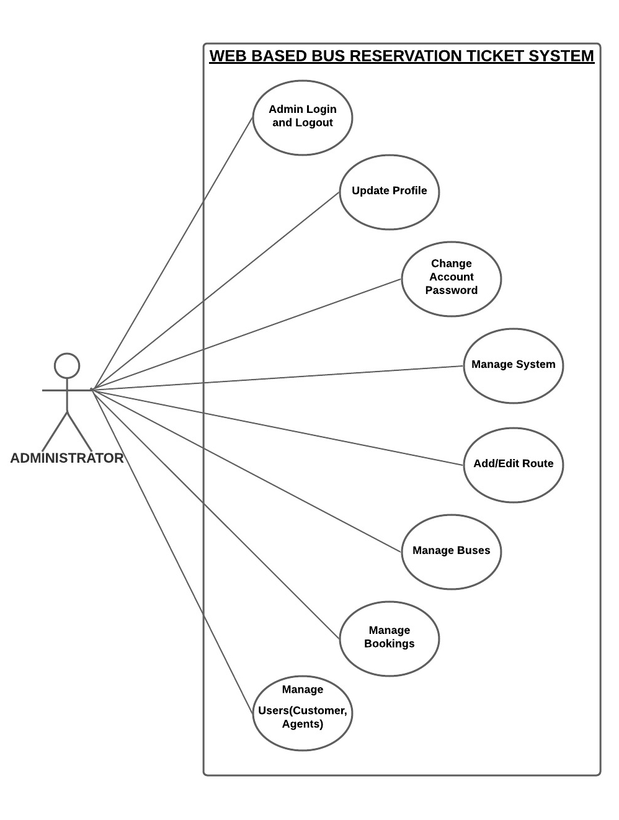
USE CASE DIAGRAM (FOR SYSTEM ADMIN)

